Slide 1

Healthcare PGP
Student Name: Ruturaj Varne

Slide 2
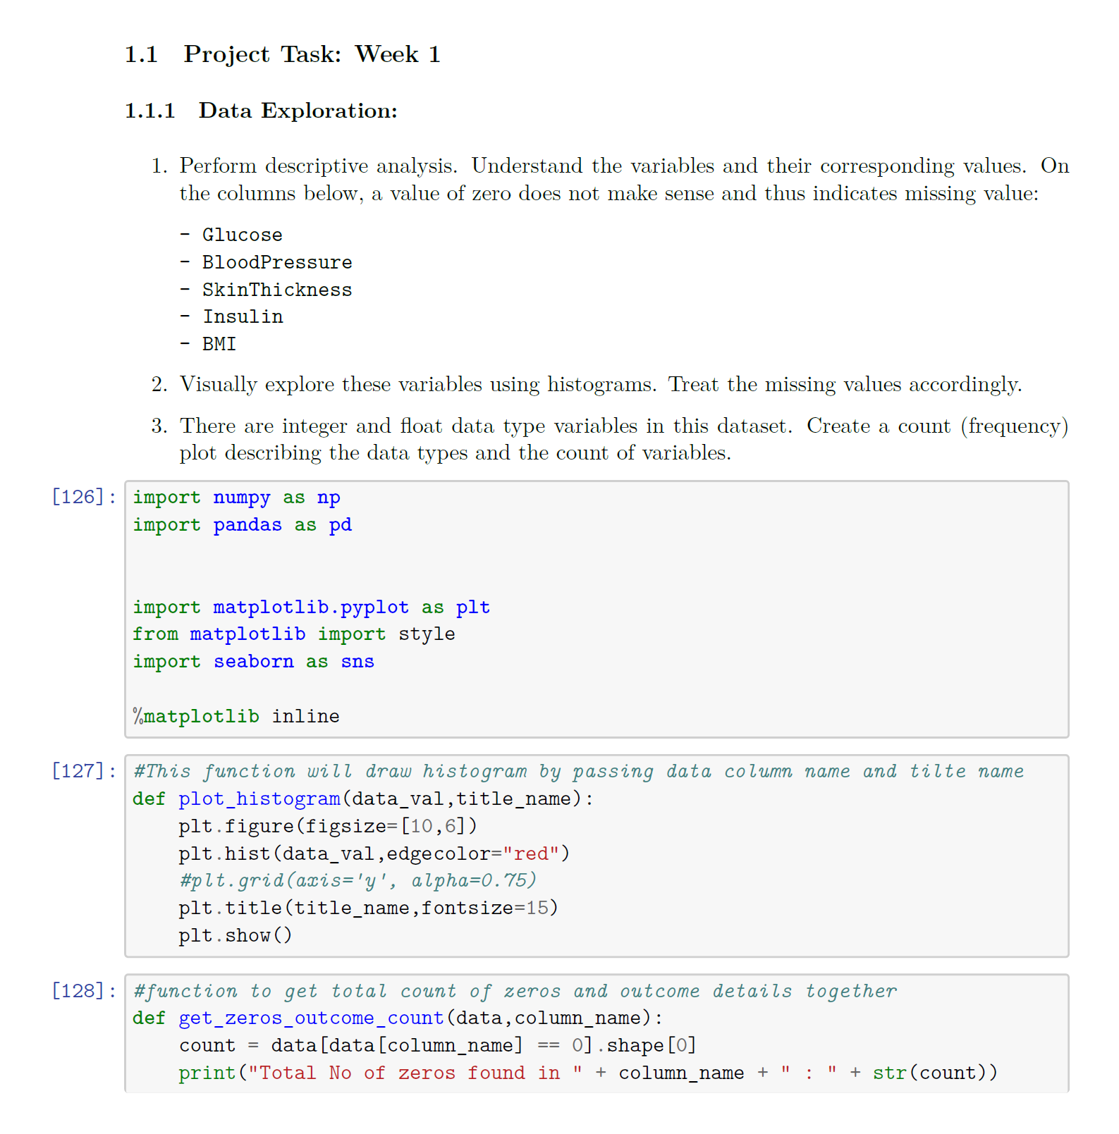
Python Code Snippet
Please refer to attachment below for full code and result.

Slide 3
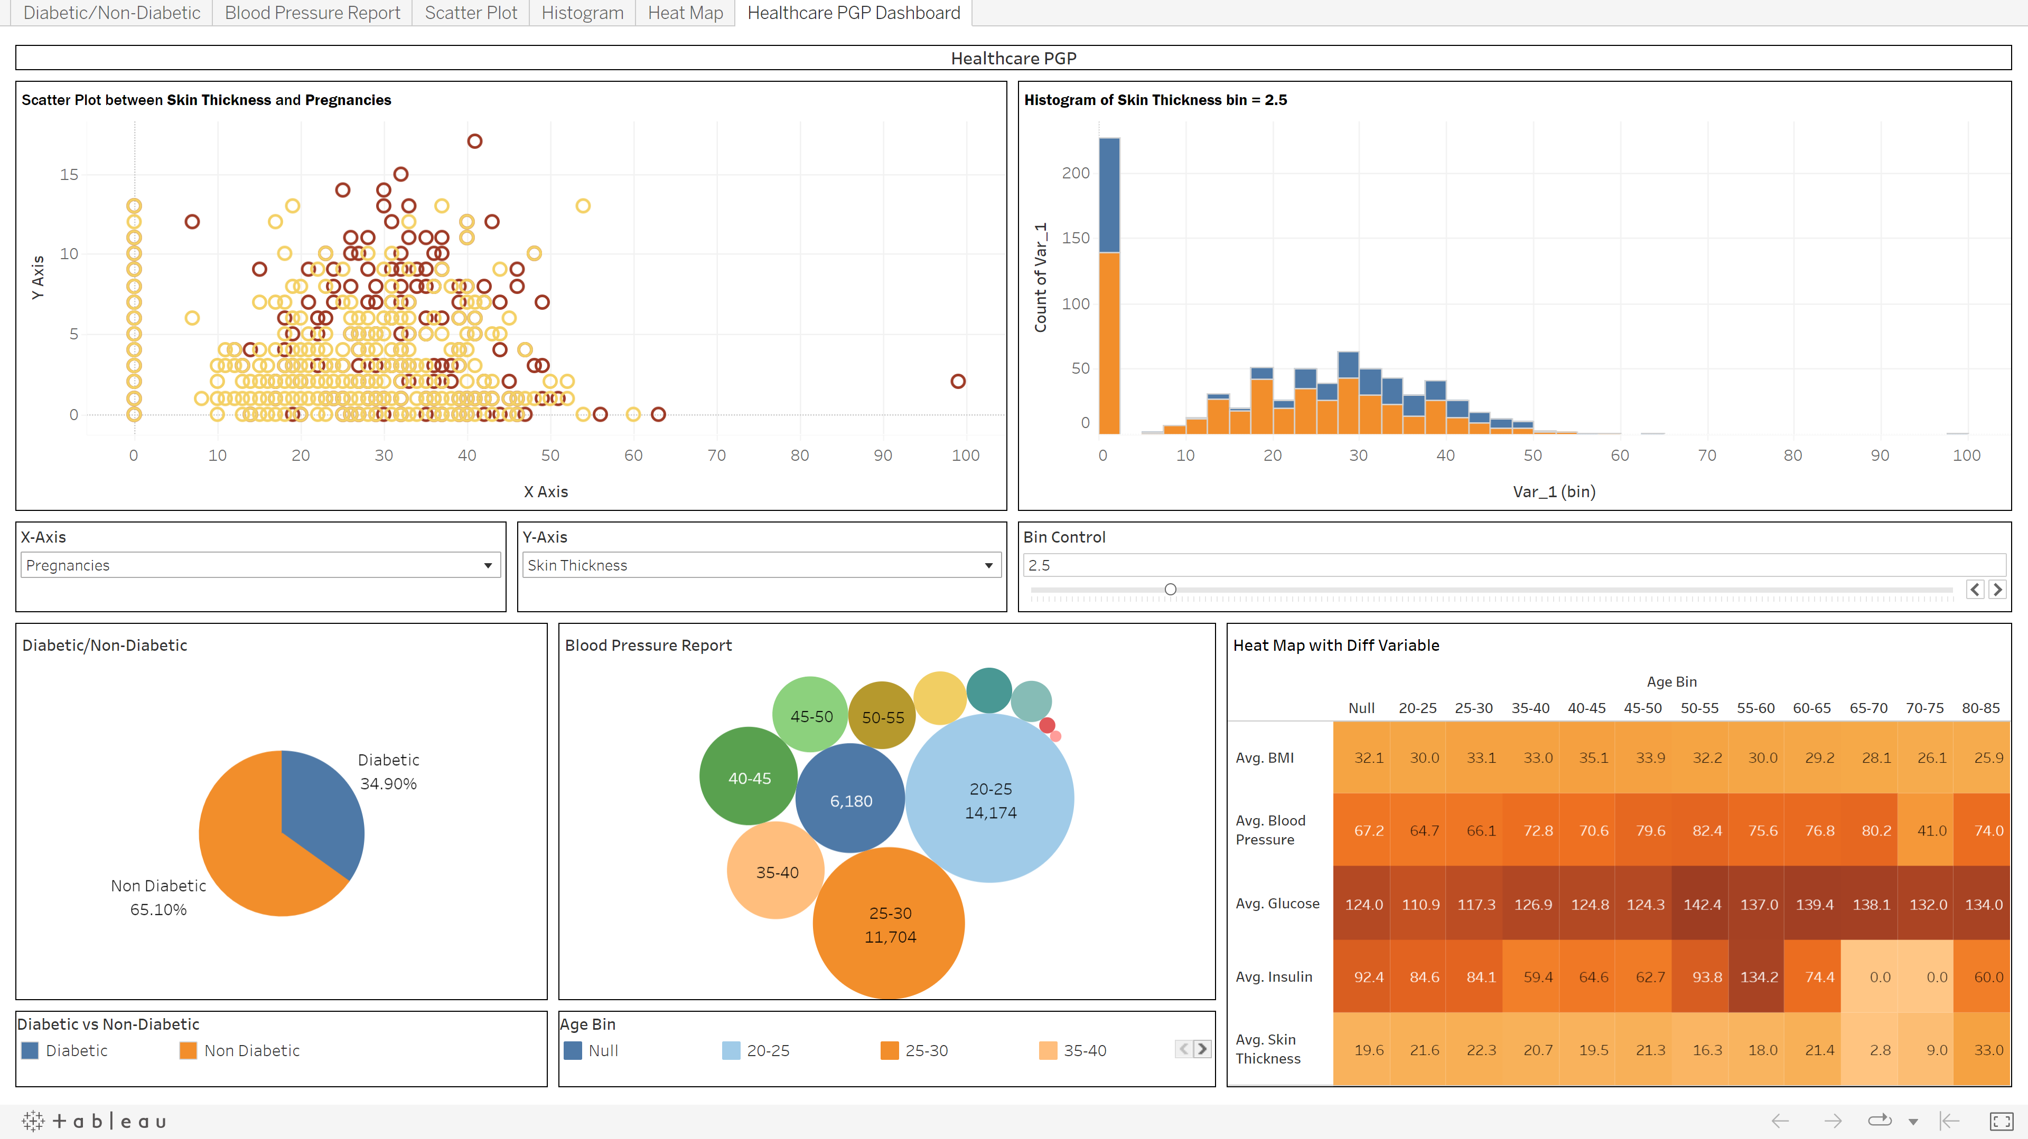
Tableau Dashboard Screenshot
Please refer to below attachment for workbook and screenshots.

Slide 4
Important Project Artifacts
Tableau Link
https://public.tableau.com/views/HealthcarePGP_16722699126210/HealthcarePGPDashboard?:language=en-US&publish=yes&:display_count=n&:origin=viz_share_link
Git Repo Link
https://github.com/ruturajvarne/datasciense-capstone-project.git

Slide 5
Thank You…
First of all I would like to THANKS Simplilearn Team for such great arrangement of Data science Sessions. This definitely helped me to scale up my Knowledge.
Second BIG THANKS to all the mentors/instructors. All the knowledge gained during these session is priceless.
Finally, Best of luck Simplilearn Team for future endeavor.

